Slide 1

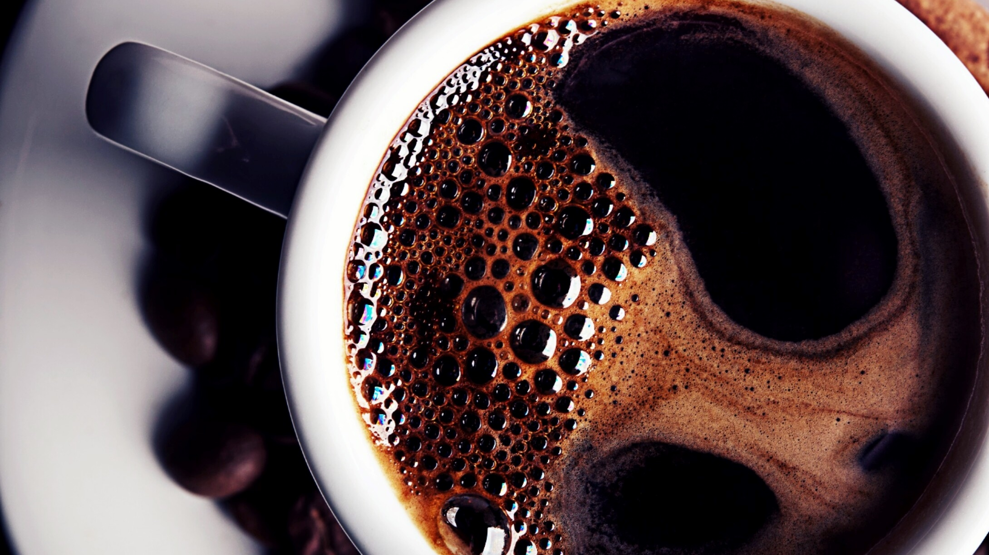
Coffee & Magic
Liran Naaman

Slide 2
Coffee in NYC
The problem: Where can you find starbucks in NYC?
01
The data.
02
Results.
03

Slide 3
We all need coffee
Most people need coffee.
The magic potion brings us back to life.
But where can you drink coffee while away from your favorite coffee shop?
In this presentation I will use the data of Starbucks locations in NYC to help finding this needed cup of Jo.

Slide 4
DATA
The data I will use is a Json file including coordinates of the NYC Starbucks.
The data will be presented using a Folium map with markers.
Lastly, I will provide you with the location with the highest concertation of Starbucks in NYC.

Slide 5
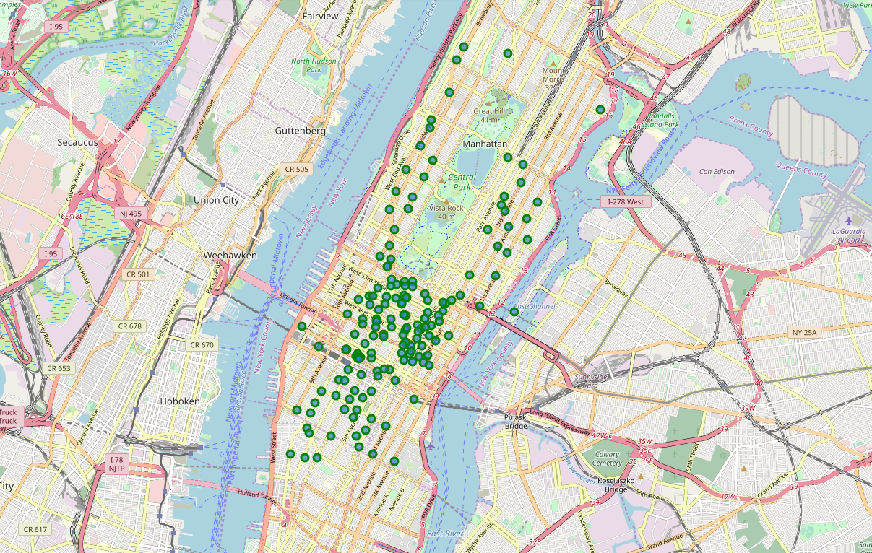
RESULTS
NYC MAP

Slide 6
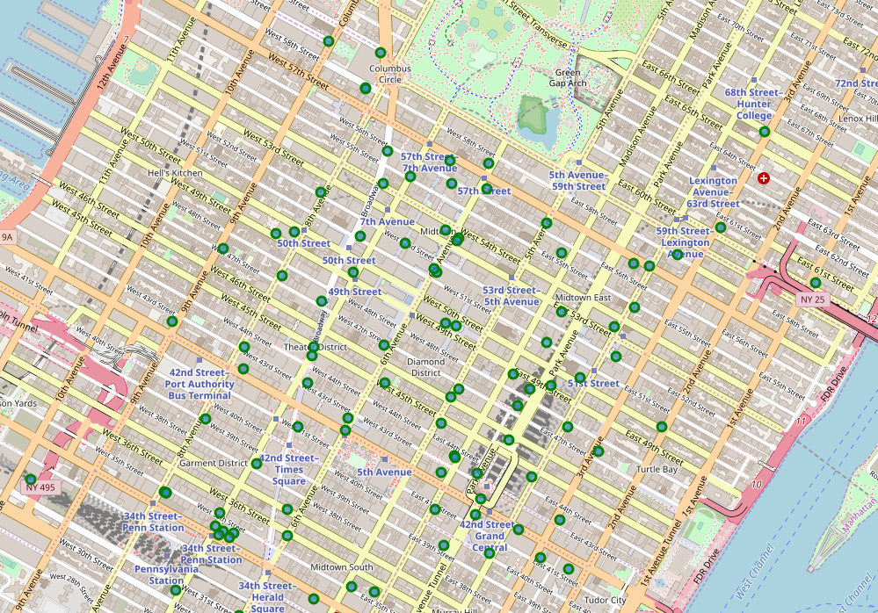
RESULTS
NYC MAP
Times Squares/
South central park.

Slide 7
DISCUSSION
In this presentation I provided with the location of all the Starbucks locations in NYC.
The data used in this presentation is the geolocations in a Json format.
The data presented in the Folium map, using markers to pinpoint the Starbucks locations.
The data shows the most Starbucks are located in Time’s Squares and the south of Central Park.

